Slide 1
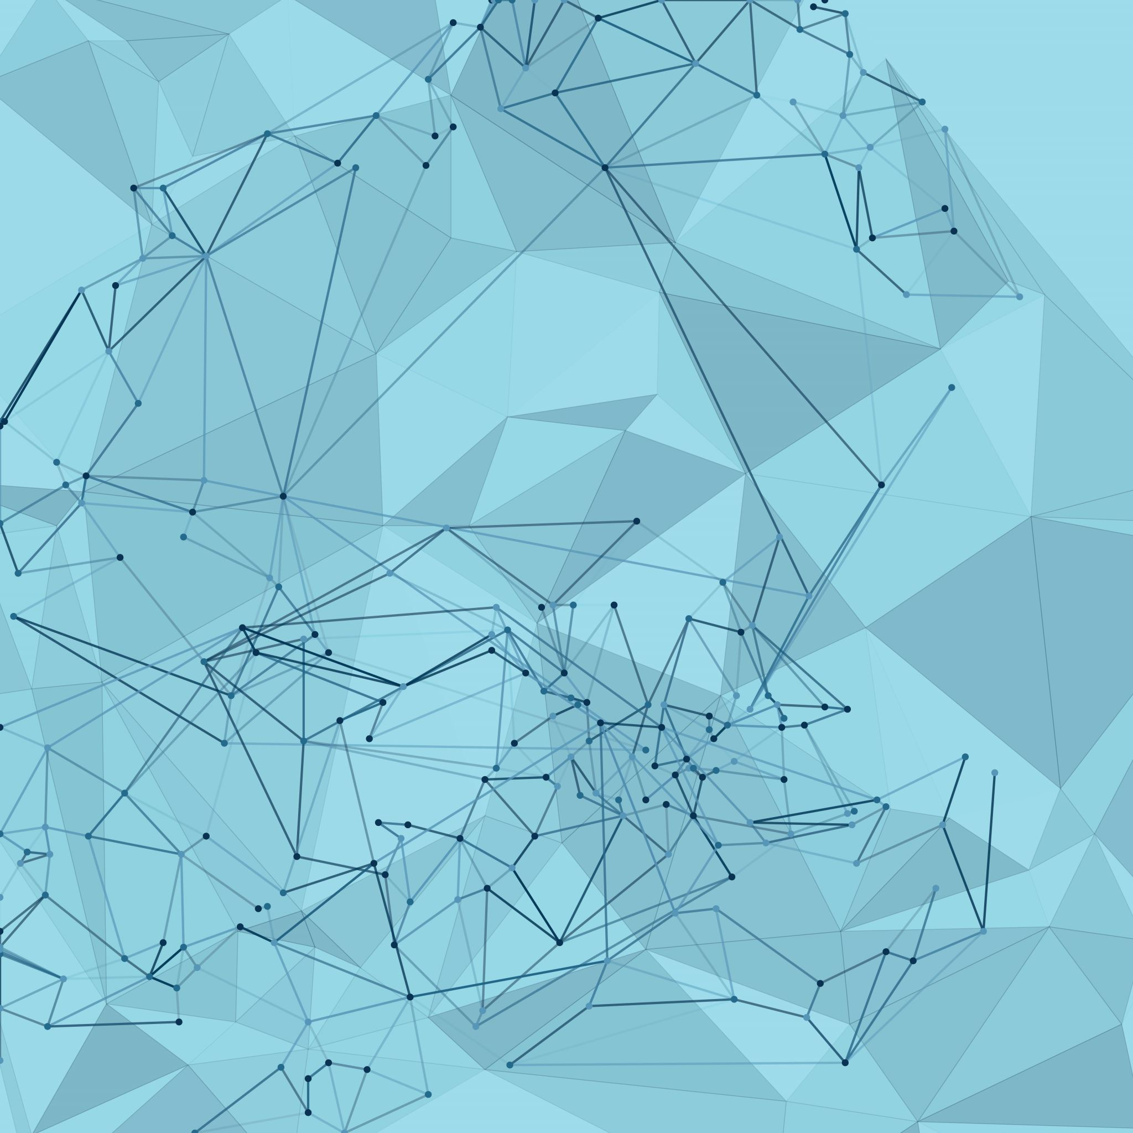
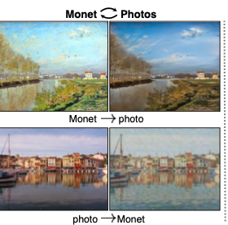
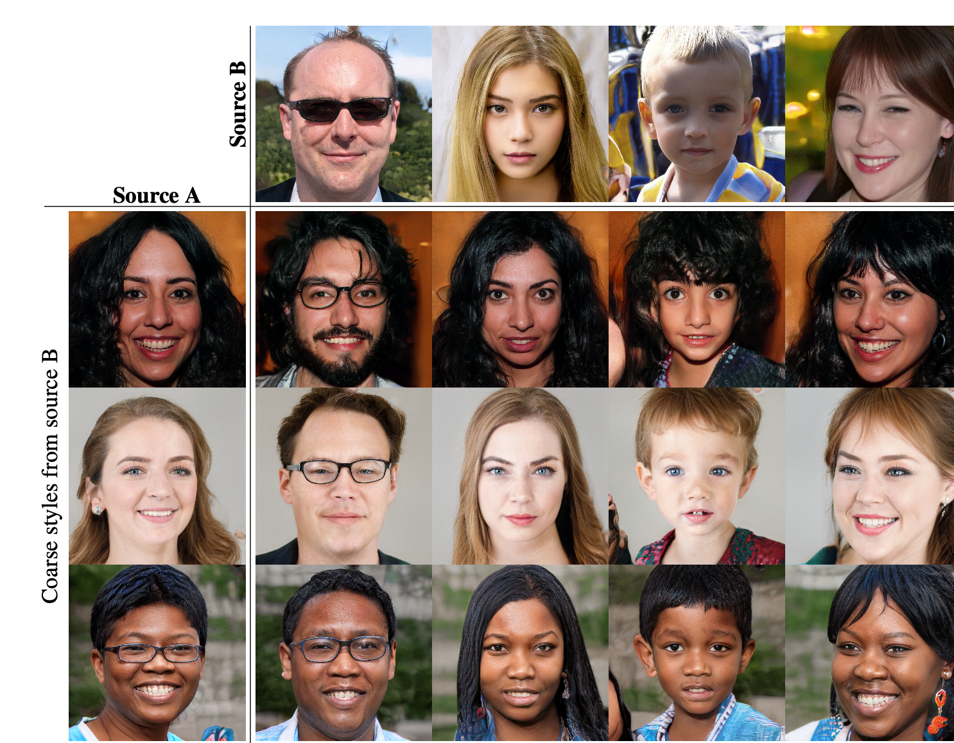
Generative AI Assignment 5 – Exploring CycleGAN and StyleGAN
By Soeb Hussain
002747200

Slide 2
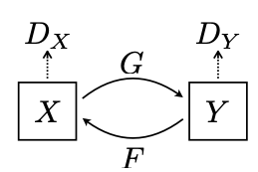
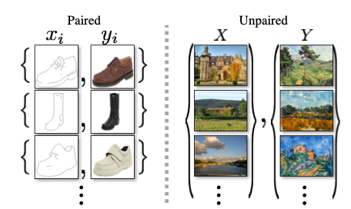
CycleGAN, what if Monet Happened upon the little harbor on a cool summer evening
Goal is to learn a mapping G: X ->Y such that the distribution of images from G(X) is indistinguishable from the distribution Y using an adversarial loss (cycle consistency loss)
Approach of learning to translate an image from a source domain X to a target domain Y in absence of paired examples

Slide 3
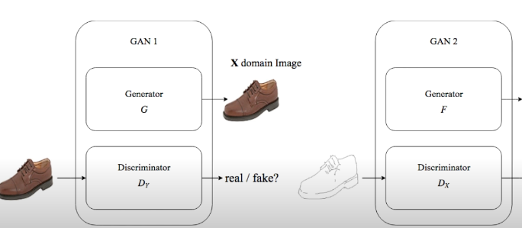
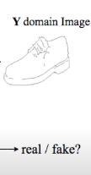
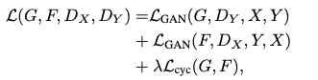
Cycle-GAN
CycleGAN architecture consists of two generators and two discriminators
Generator 1: Translates images from Domain A to Domain B
Generator 2: Translates images from Domain B to Domain A
Discriminator 1: Distinguishes real Domain B images from generated ones
Discriminator 2: Distinguishes real Domain A images from generated ones
The cycle-consistency loss enforces that going from A to B and back to A should be close to the original image
Key Features:
Unpaired image translation (no need for matching pairs of images)
Cycle-consistency: Ensures that translating from Domain A to B and back to A yields the original image
Objective function: adversarial loss + cycle consistency loss

Slide 4
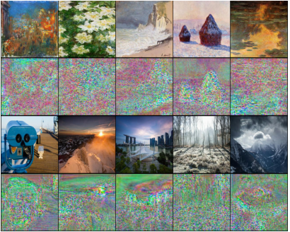
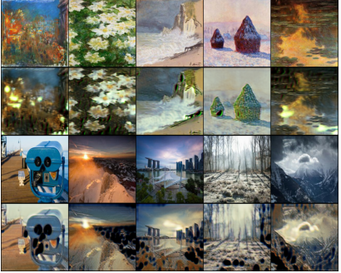
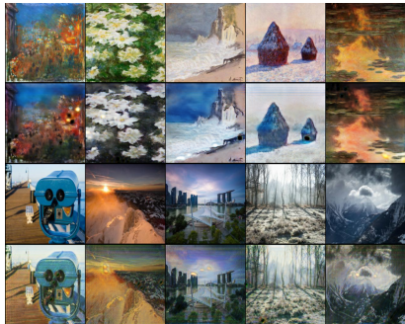
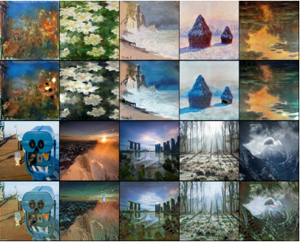
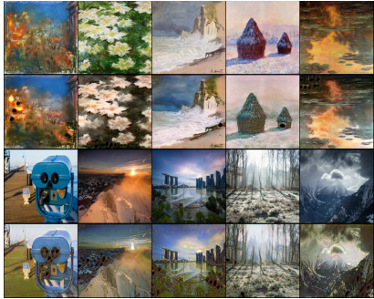
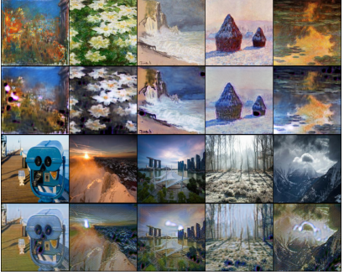
Training
LR 2e-4, beta1 0.5 and beta2 0.999
Adam optimizer used
Epochs 100
Decay-epoch 20

Slide 5
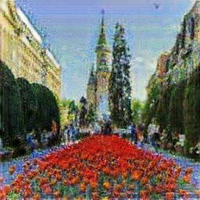
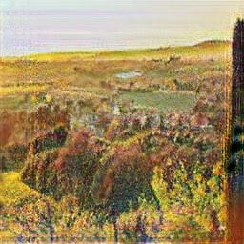
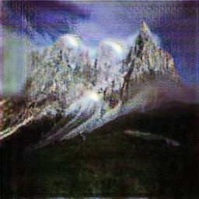
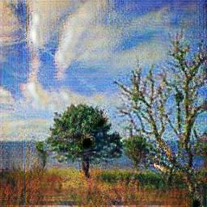
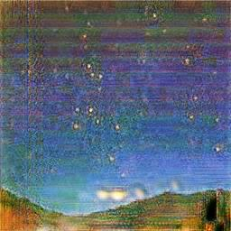
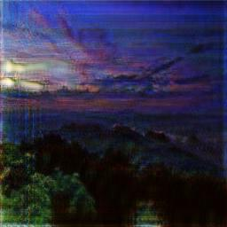
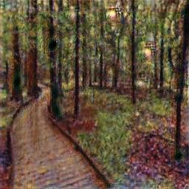
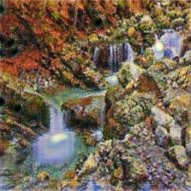
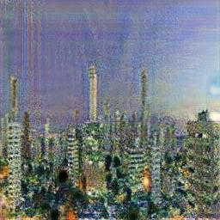
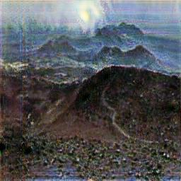
Generated new Images

Slide 6
Style GAN
This architecture leads to an automatically learned, unsupervised separation of high level attributes and stochastic variation in the generated images
Traditionally, a latent code is provided to the generator through an input layer, this design omitted the input layer altogether and start from a learned constant instead.
Discriminator will be like previous GANs, the novelty is on Generator

Slide 7
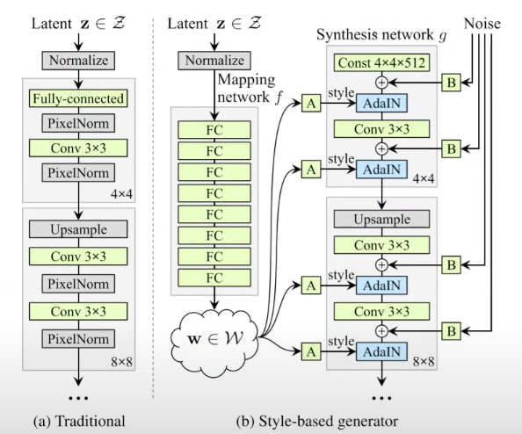
Generator Architecture
Latent noise passed through a collection of fully connected layerkeeping the dimension same as 512
Leads to a more dis-entangled latent space
Noise is standard normal distribution
ProGAN, pixelNorm is replaced by adaptive instance normalization

Slide 8
Mixing Noise to generated Image
Alpha controls how much noise can be added to the new image
Block B multiply the noise to weight before adding it to the image (learned per channel scaling factor)
Block A is learned Affine Transformation
Mapping network consist of 8 layers (MLP) and Synthesis Layer consist of 18 layers
Parameter 26.2M

Slide 9
Training Detail
Data set FFHQ
Discriminator reused from proGAN Karras et al
Time one week
8 Tesla V100 GPUs
LR 0.002
Leaky relu alpha 0.2
Loss changed from WGAN_GP -> GANloss + R1

Slide 10
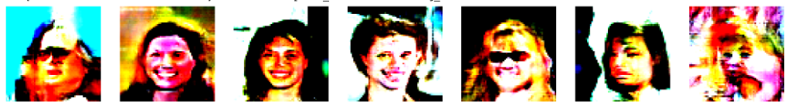
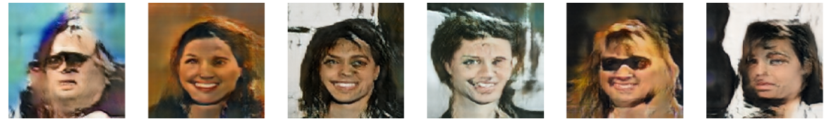
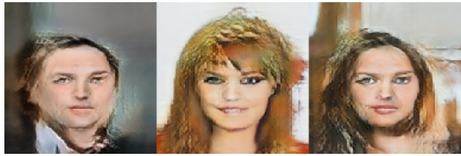
Training Output
Mixing Image with Noise

